Slide 3
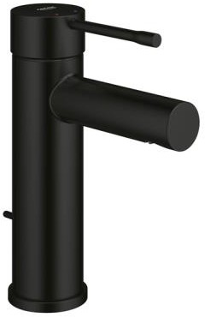
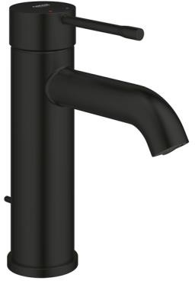
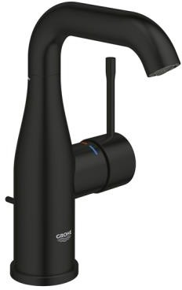
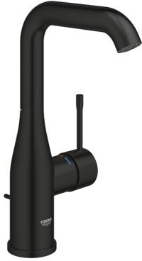
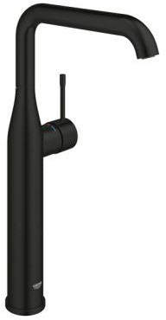
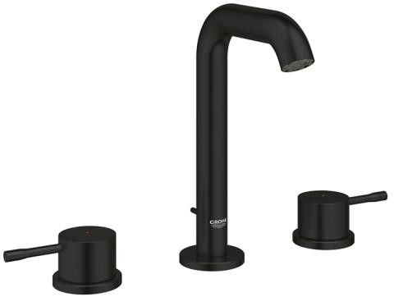
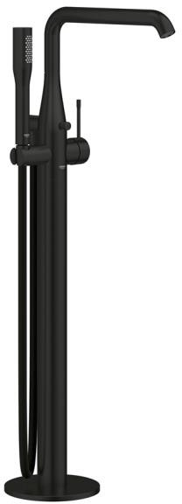
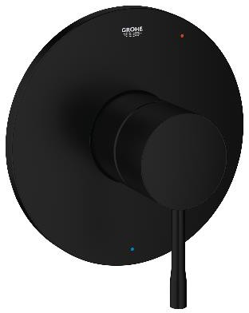
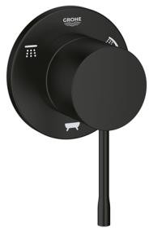
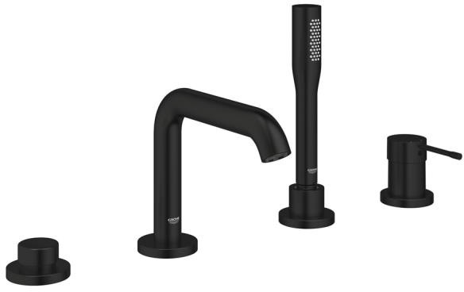
GROHE MATTE BLACK EXPANSION
ESSENCE BATH COLLECTION
00
243
EN
A0
GN
Single Handle Bathroom Faucet S-Size
Single Handle Bathroom Faucet S-Size
Single Handle Bathroom Faucet M-Size
Single Handle Bathroom Faucet L-Size
Single Handle
Vessel
Widespread Bathroom Faucet M-Size
3-Way Diverter
Trim
Essence LH Trip Lever
Four-Hole Roman Tub Filler with Hand Shower
Freestanding Tub Faucet with Hand Shower
Essence Pressure Balance Valve Trim

Slide 4
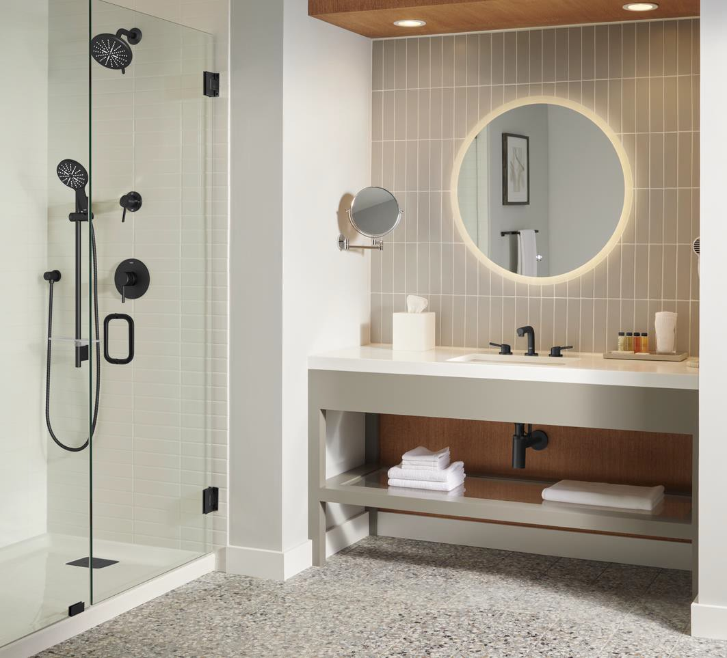
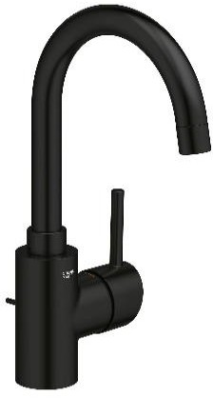
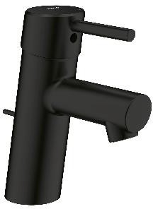
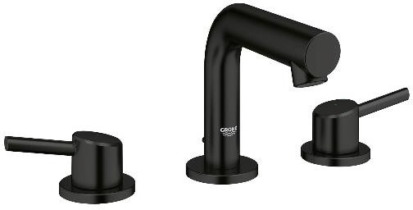
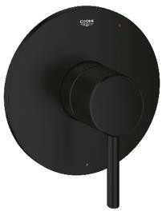
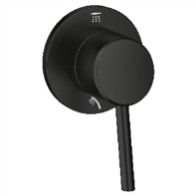
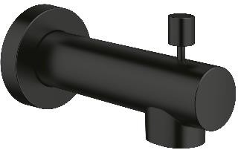
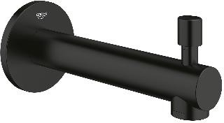
GROHE MATTE BLACK EXPANSION
CONCETTO COLLECTION
GROHE MATTE BLACK EXPANSION
CONCETTO COLLECTION
00
243
EN
Single Handle Bathroom Faucet S-Size
Widespread Bathroom Faucet S-Size
Single Handle Bathroom Faucet L-Size
Pressure Balance Valve
Trim w/Cartridge
2-Way Diverter Trim
(Shower/Hand Shower)
4.5” Diverter Tub Spout
6.5” Diverter Tub Spout
Tub Spout

Slide 5
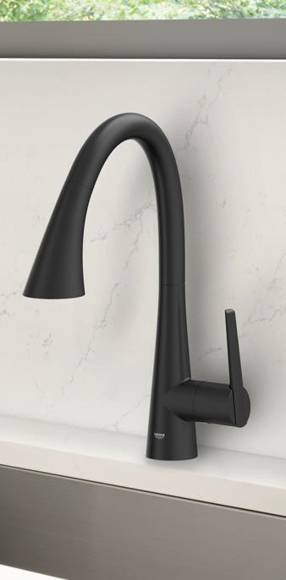
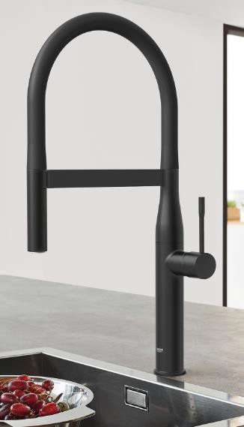
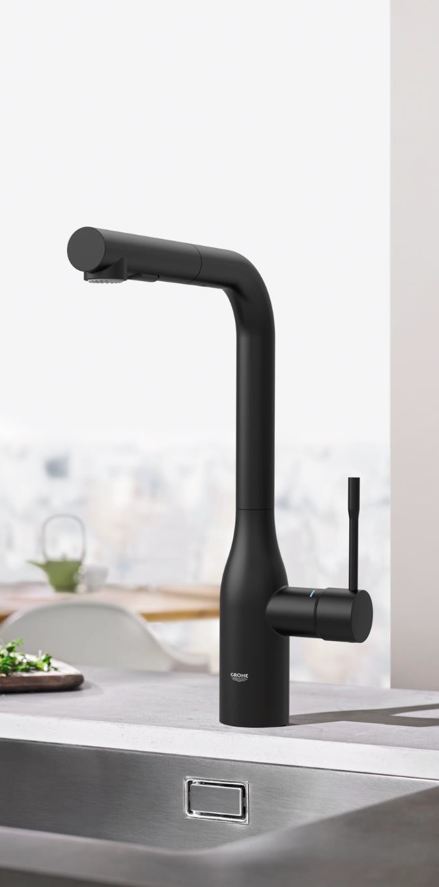
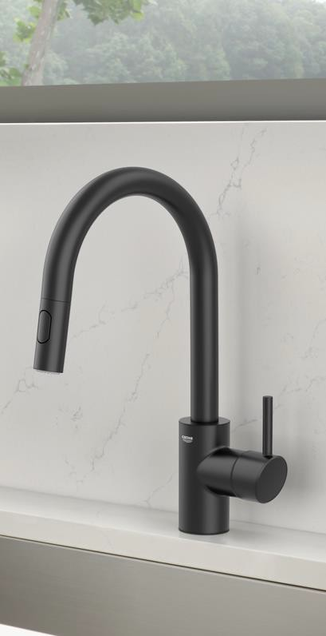
GROHE MATTE BLACK EXPANSION
ZEDRA, ESSENCE AND CONCETTO KITCHEN
GROHE Zedra
Single Handle Pull-Down,
Triple Spray and Dual Spray* not shown
Essence Single Handle Semi-Pro
Essence Single Handle Pull-Out
Concetto Single Handle Pull-Down

Slide 6
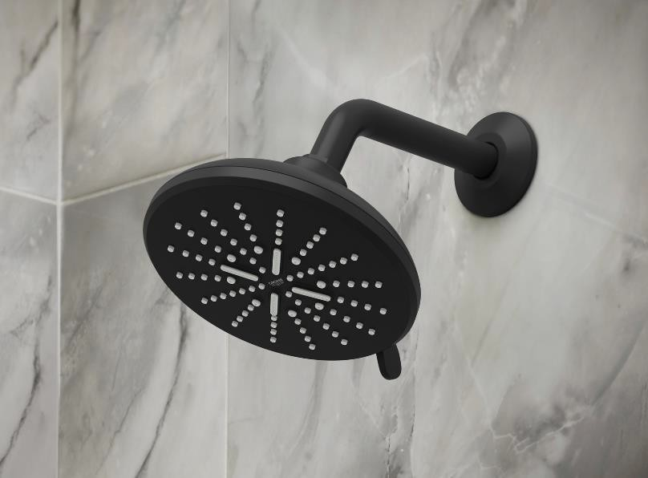
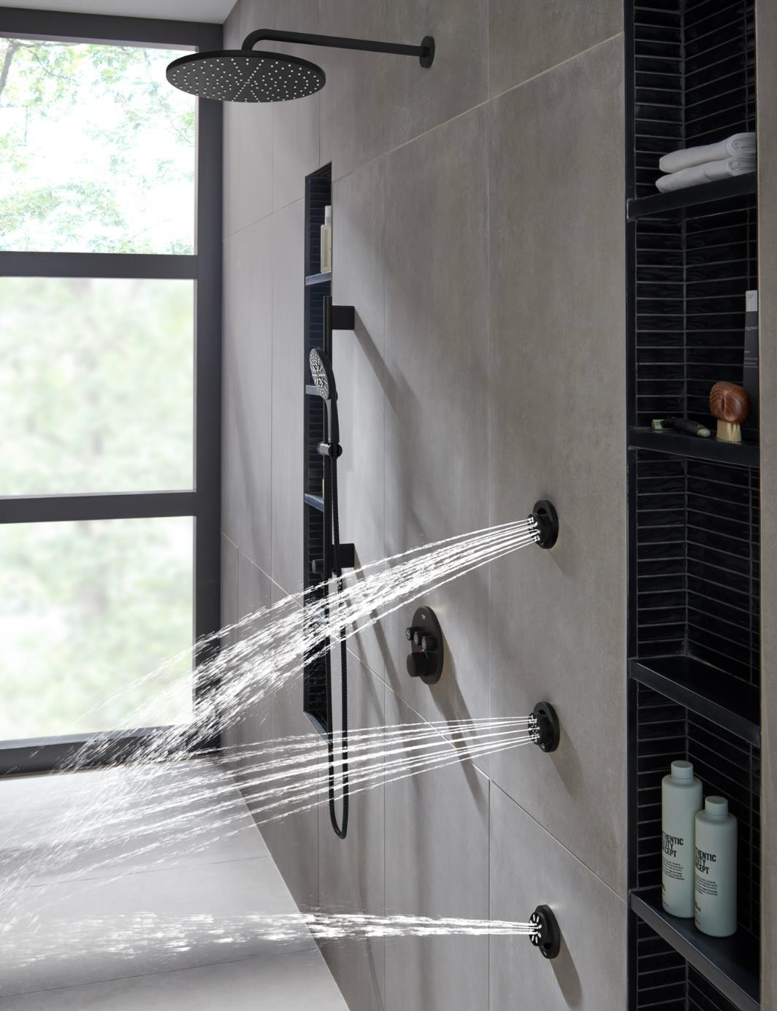
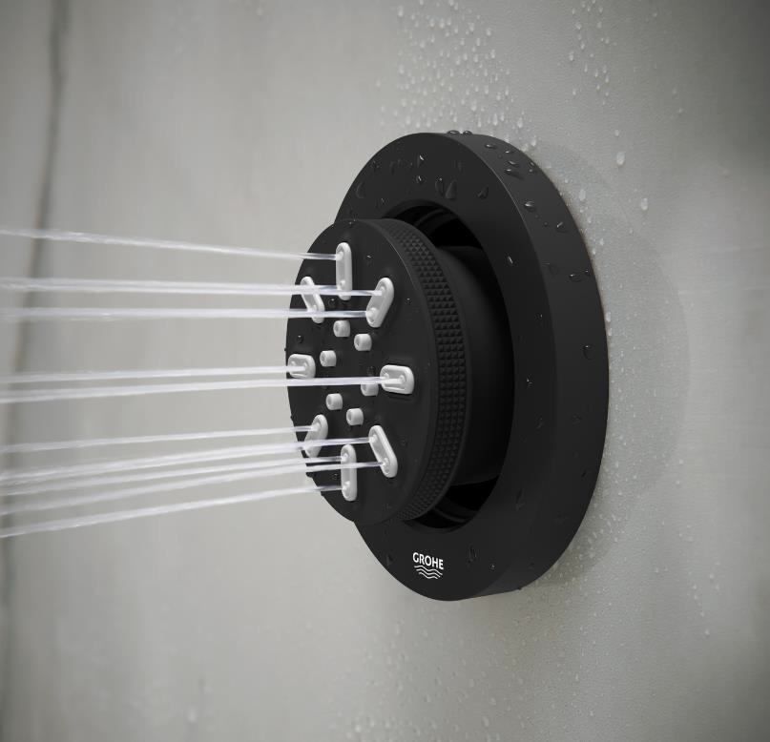
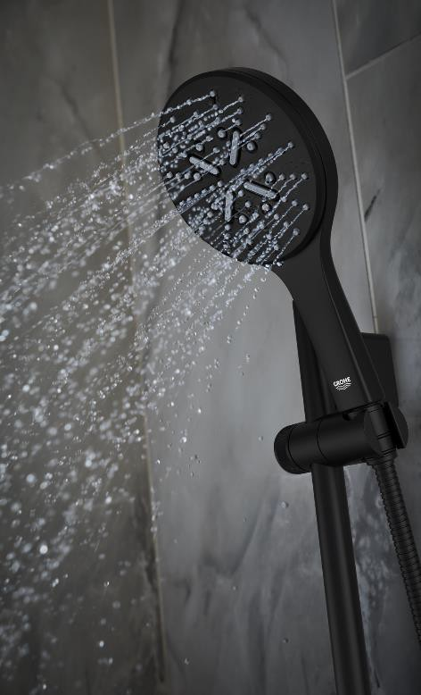
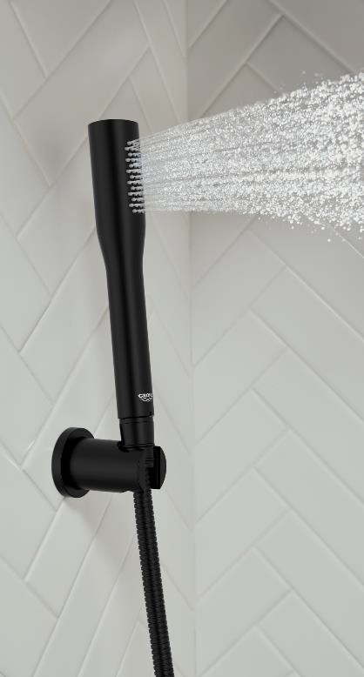
GROHE MATTE BLACK EXPANSION
SHOWERING
SmartActive Shower Head
Tempesta 250 Rain Shower Head
SmartActive
Hand Shower
Euphoria Stick
Hand Shower
Rainshower Aqua Body Spray

Slide 7
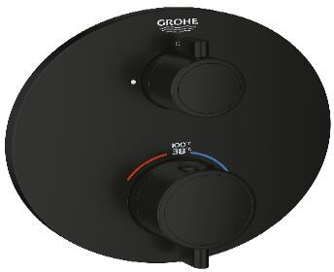
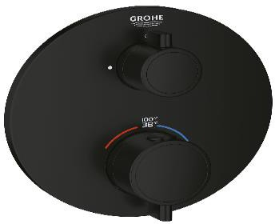
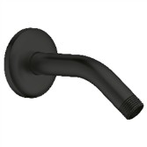
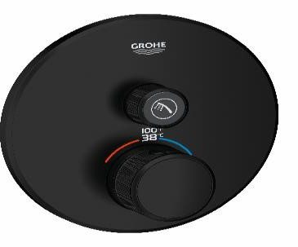
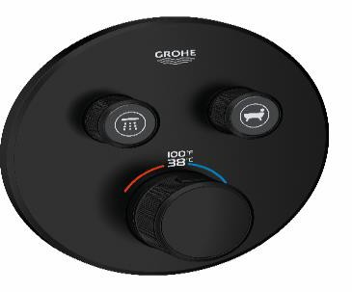
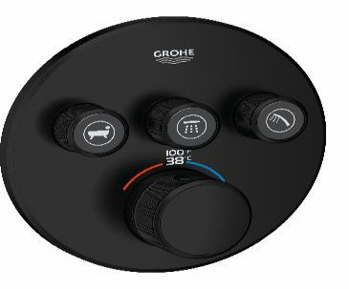
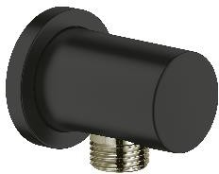
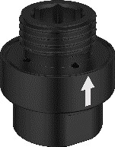
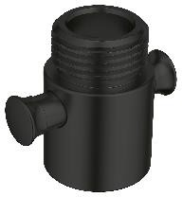
GROHE MATTE BLACK EXPANSION
CUSTOM SHOWERING
Thermostatic Trims
Shower Arms
Hand Shower Bars
Rainshower 15” Shower Arm Round
5-⅝” Tubular Shower Arm
12” Ceiling Mount Arm Round
Grohtherm Round Single Function Grohtherm Round Dual Function
2-Handle Thermostatic Trim 2-Handle Thermostatic Trim
Hand Shower Accessories
Rainshower 24”
and 36” Shower
Bar
Rainshower Wall Hand Shower Holder
Rainshower Wall Shower Union, ½”
RotaFlex Metal Hose 69”
36” Tempesta Cosmopolitan Shower Bar
Grohtherm Smartcontrol Single Function Thermostatic Trim
Grohtherm Smartcontrol Dual Function Thermostatic Trim
Grohtherm Smartcontrol Triple Function Thermostatic Trim
½” Inline Vacuum Breaker for Hand Showers
Non-Positive Shut Off Valve for Hand Showers
RotaFlex Metal
Hose 59”

Slide 8
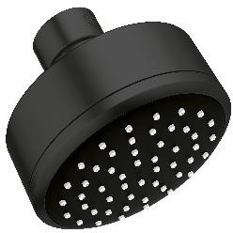
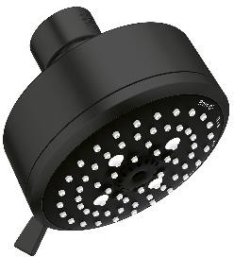
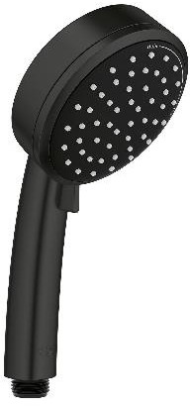
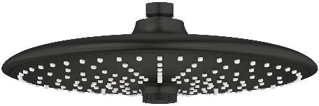
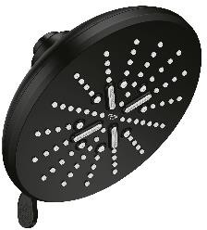
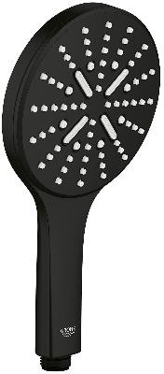
GROHE MATTE BLACK EXPANSION
SHOWER HEADS, HAND SHOWERS AND BODY SPRAYS
Tempesta Collection
Euphoria Collection
Tempesta 250 Rain Shower
Tempesta Cosmopolitan 100 Shower Head
Tempesta Cosmopolitan 100 Shower Head,
4 sprays
Euphoria 260 Rain Shower, 3 sprays
Tempesta Cosmopolitan 100 Hand Shower, 2 sprays
Euphoria Stick
Hand Shower
Rainshower Collection
Body Spray
Rainshower 310 Mono Shower Head - Round
SmartActive Shower Head Round,
3 sprays
Rainshower Aqua Body Spray - Round
Rainshower SmartActive
Hand Shower Round, 3 sprays

Slide 9
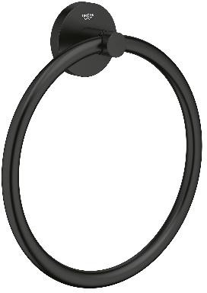
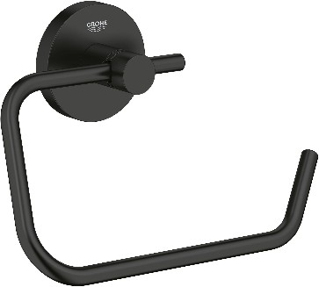
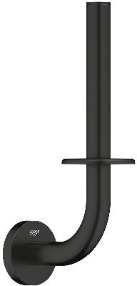
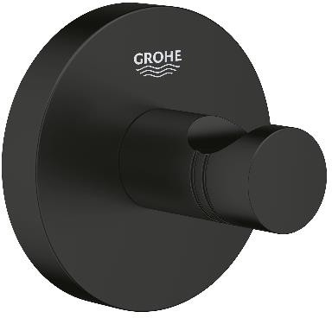
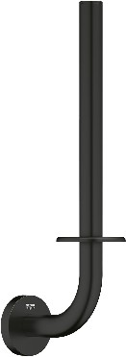
GROHE MATTE BLACK EXPANSION
ESSENTIALS ACCESSORIES
Essentials Robe Hook
Essentials Towel Ring
Essentials Covered Toilet Paper Holder
Essentials Paper Holder
Essentials Spare Paper Holder
Essentials Towel Bar 32”
Essentials Towel Bar 24”
Essentials Towel Bar 18”
Essentials Grab Bar 12”
Essentials Double Toilet Paper Holder

